Slide 1
ATACseqQC: A Bioconductor package for post-alignment quality control of ATAC-seq data
Haibo Liu
Department of Animal Science, Iowa State University
Jianhong Ou
Department of Cell Biology, Duke University Medical Center, Duke University
Lihua Julie Zhu
Department of Molecular, Cell and Cancer Biology, Program in Molecular Medicine, Program in Bioinformatics and Integrative Biology, UMass Medical School

Slide 2
Outline
Introduction to the ATAC-seq technology
Preprocessing of ATAC-seq data
ATACseqQC workflow
Exercises and live demonstration
Best practices of ATAC-seq assays and ATAC-seq data analyses
Acknowledgement

Slide 3
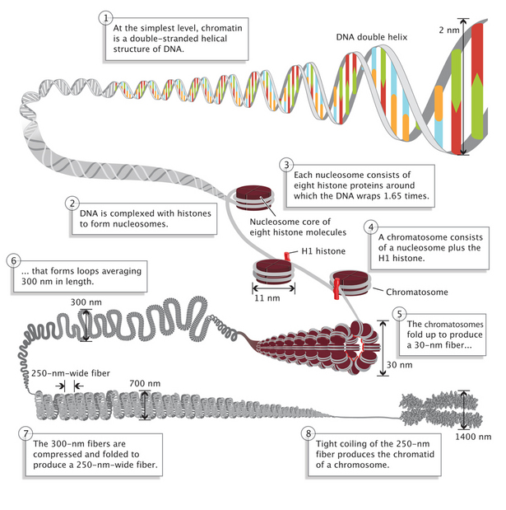
DNA packaging in Eukaryotic cells
Nature Education 1(1):26 (https://www.nature.com/scitable/topicpage/dna-packaging-nucleosomes-and-chromatin-310)

Slide 4
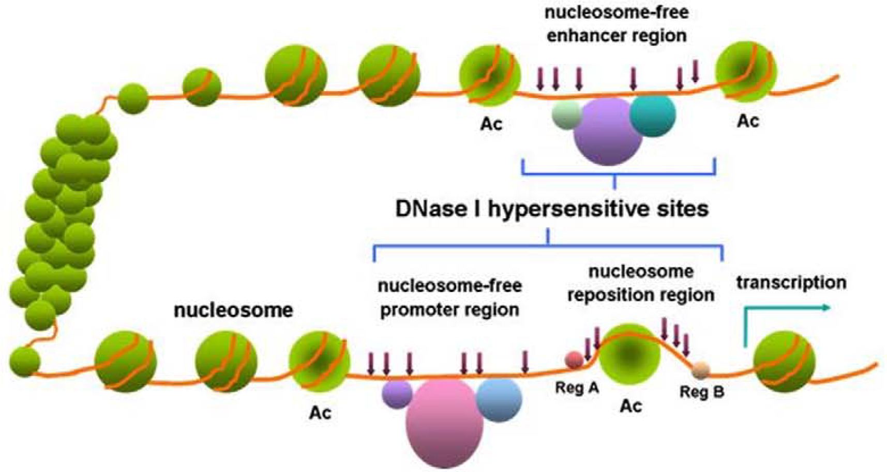
Open and closed chromatin
(Wang et al. 2012)

Slide 5
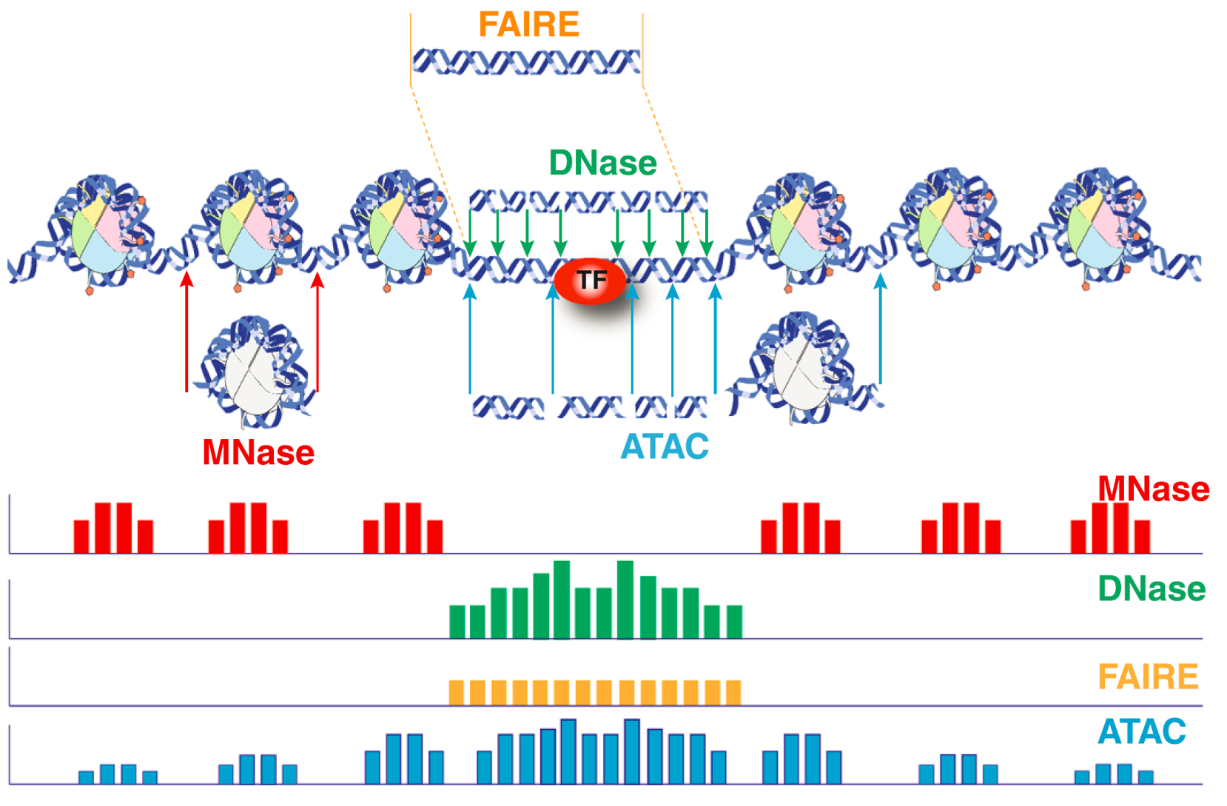
Methods for profiling chromatin accessibility
(Tsompana and Buck. 2014)

Slide 6
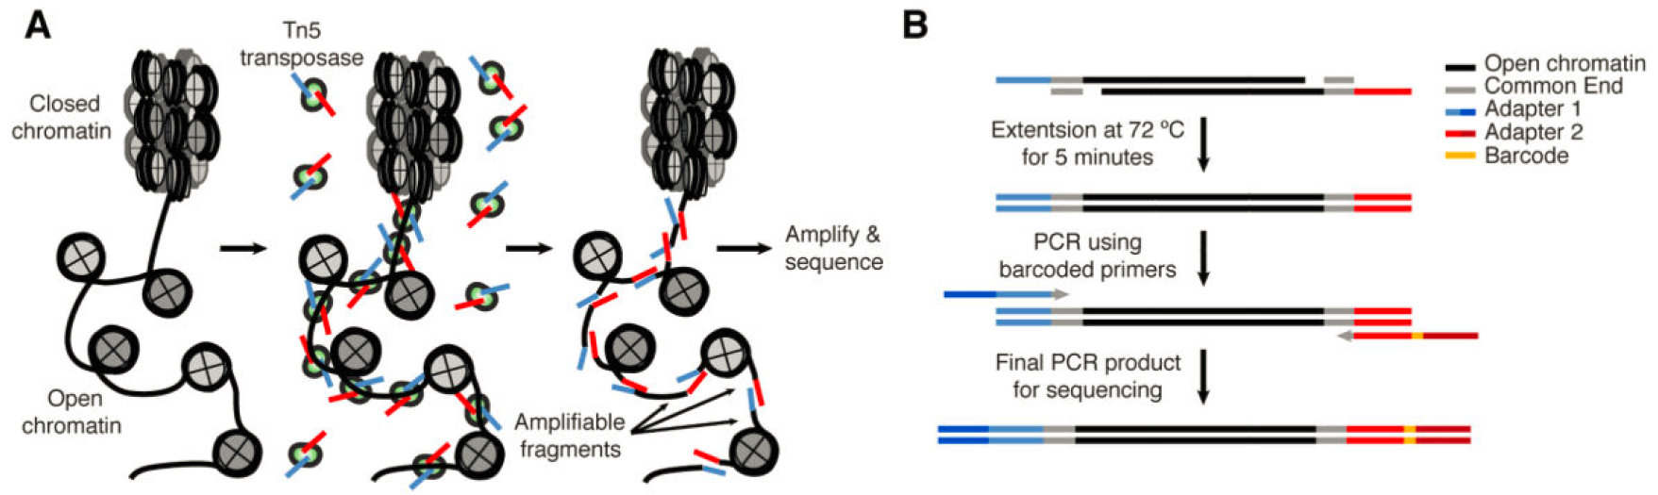
Workflow of ATAC-seq assays
(Buenrostro et al. 2013)

Slide 7
Applications of ATAC-seq
Infer nucleosome positioning
Profile open chromatin regions
Identify transcription factor (TF) footprints
Infer gene transcriptional regulation
Determine cell state/identity in combination with single cell technologies (scATAC-seq)

Slide 8
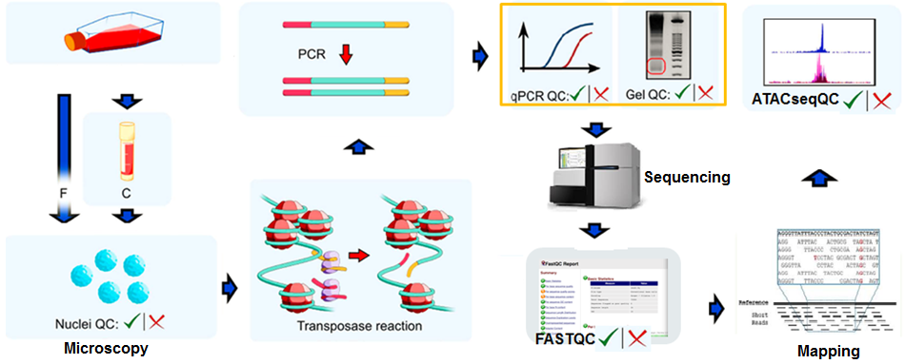
Important QC steps in ATAC-seq
(Modified from Milani et al. 2016)

Slide 9
Outline
Introduction to the ATAC-seq technology
Preprocessing of ATAC-seq data
ATACseqQC workflow
Exercises and live demonstration
Best practices of ATAC-seq assays and ATAC-seq data analyses
Acknowledgement

Slide 10
Preprocessing of ATAC-seq data
Check quality of raw reads using (FASTQC).
Generate an interactive summary report as a HTML file (MultiQC)
Optionally, trim sequencing adapters and low quality bases using (Trimmomatic or Trim Galore!)
Map the reads to the reference genome of choice (Bowtie/Bowtie2 or BWA-mem)
Convert and sort alignment files (SAMtools or sambamba)
Filter aligned reads
Remove reads derived from organelles using SAMtools
Mark/remove duplicates (Picard tools)
Remove mapping artifacts (fragments < 38 bp and fragments > 2 kb, reads with un-coordinated mapping) (custom scripts)

Slide 11
Outline
Introduction to the ATAC-seq technology
Preprocessing of ATAC-seq data
ATACseqQC workflow
Exercises and live demonstration
Best practices of ATAC-seq assays and ATAC-seq data analyses
Acknowledgement

Slide 12
(1) Assessing mapping status of reads from ATAC-seq
bamQC()
mapping status, such as mapping rate, duplicate rate, genome-wide distribution, mapping quality, and contamination.
requires sorted BAM files with duplicate reads marked as input.
## prepare the example BAM files for importing
bamFile <- system.file("extdata", "GL1.bam", package="ATACseqQC", mustWork=TRUE)
bamFileLabels <- gsub(".bam", "", basename(bamFile))
## bamQC
bamQC(bamFile, outPath=NULL)

Slide 13
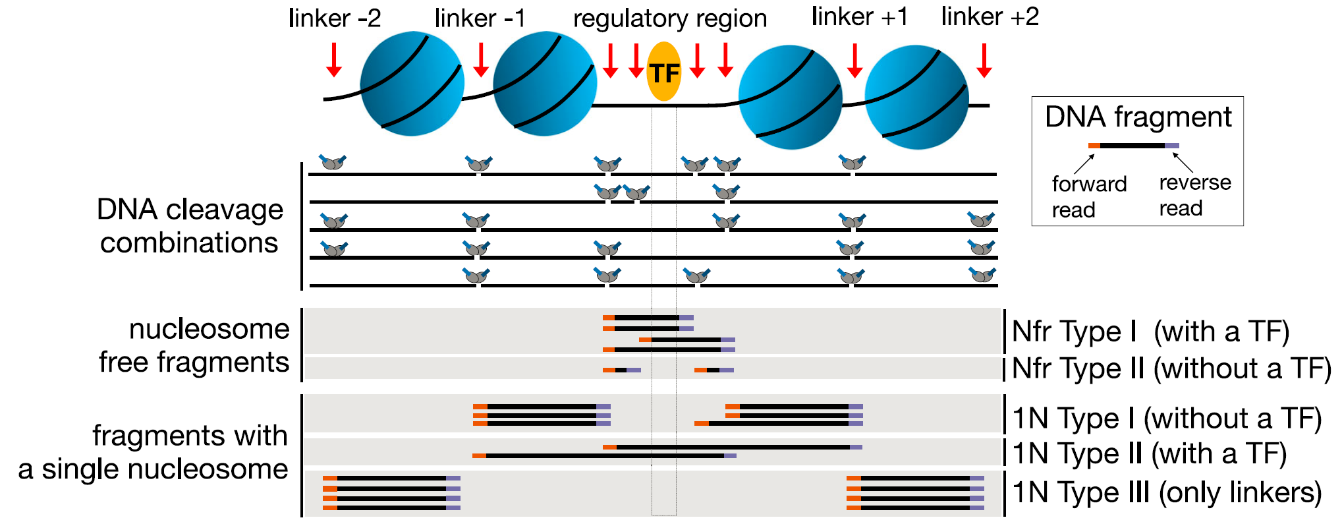
Characteristic DNA fragments generated in ATAC-seq assays
(Li et al. 2019)

Slide 14
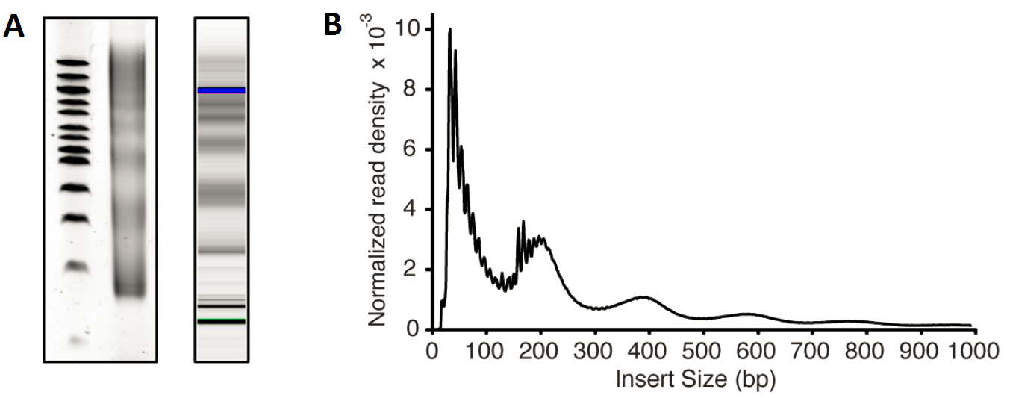
Typical size distribution of ATAC-seq library fragments/inserts
Library fragment size
Library insert size
bp
Nulceosome-free
Mononucleosome
300
Dinucleosome
200
Trinucleosome
100
Agarose gel
Bioanalyzer
(Buenrostro et al. 2015)

Slide 15


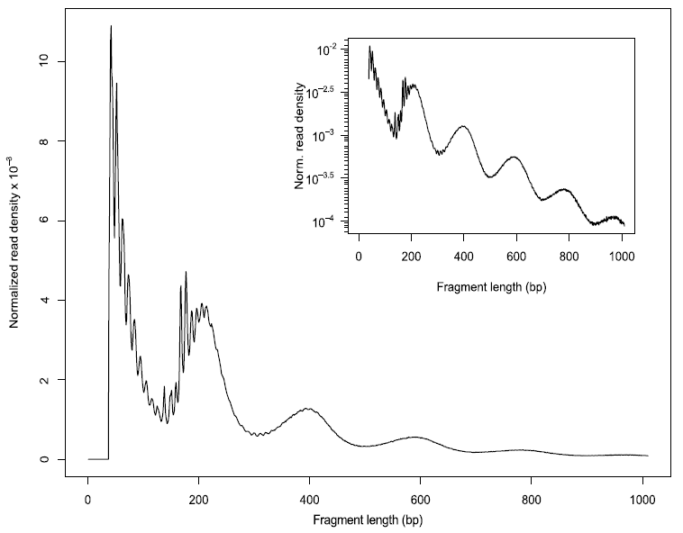
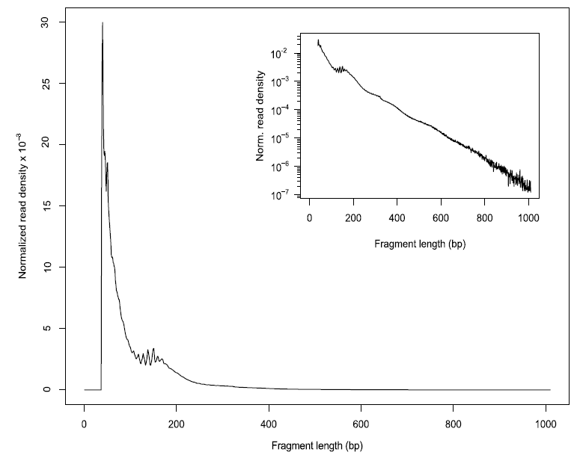
(2) Assessing insert size distribution
fragSize <- fragSizeDist(bamFile, bamFileLabels)
A (High quality)
B (Poor quality)
(Ou et al. 2018)

Slide 16
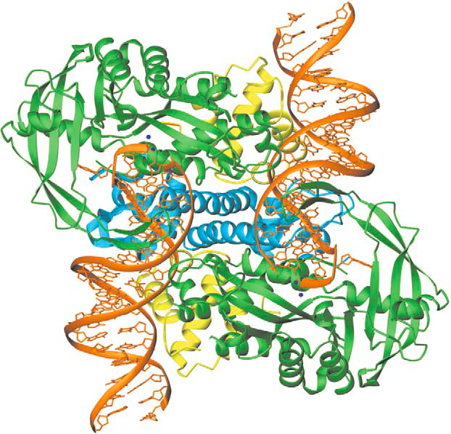
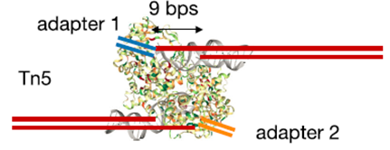
Tagmentation-mediated by preloaded Tn5 transposase produces DNA fragments with 5’ 9-base overhang ends
(Li et al. 2019)

Slide 17
(3) Shifting aligned reads
## read the BAM file
gal <- readBamFile(bamFile, tag=tags, which=which,asMates=TRUE, bigFile=TRUE)
## specifiy output directory
shiftedBamFile <- file.path(outPath, "shifted.bam")
## shift aligments
gal1 <- shiftGAlignmentsList(gal, outbam=shiftedBamFile)

Slide 18

(4) Splitting BAM files
split aligned reads into different bins:
Nucleosome-free
Mononucleosome
Dinucleosome
Trinucleosome
(Li et al. 2019)
objs <- splitGAlignmentsByCut(gal1, txs=txs,
genome=genome, outPath = outPath)

Slide 19
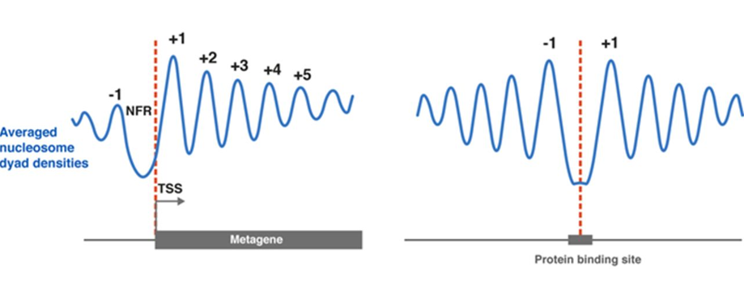
Nucleosome positioning around TSSs and TF-bound sites
A
B
(Baldi. 2018)

Slide 20
(5) Plotting global signal distribution around transcriptional start sites (TSSs)
enrichedFragments() :calculate signals around TSSs using the split BAM objects
featureAlignedHeatmap(): generate a heatmap showing signal distribution around TSSs
matplot(): summarize the signal distribution around TSSs using a density plot

Slide 21
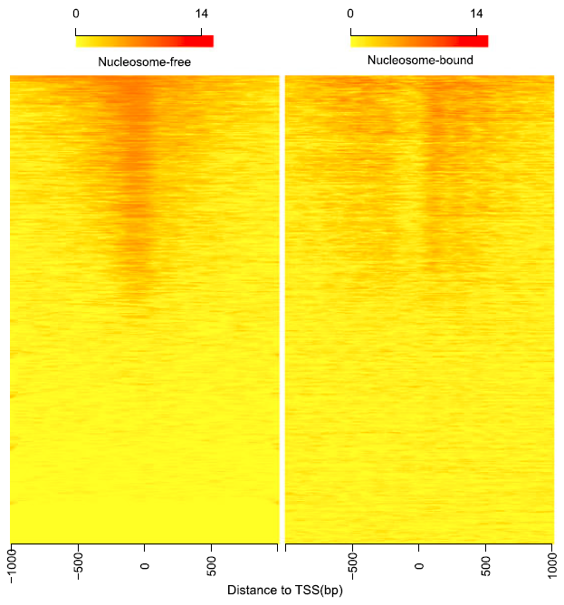
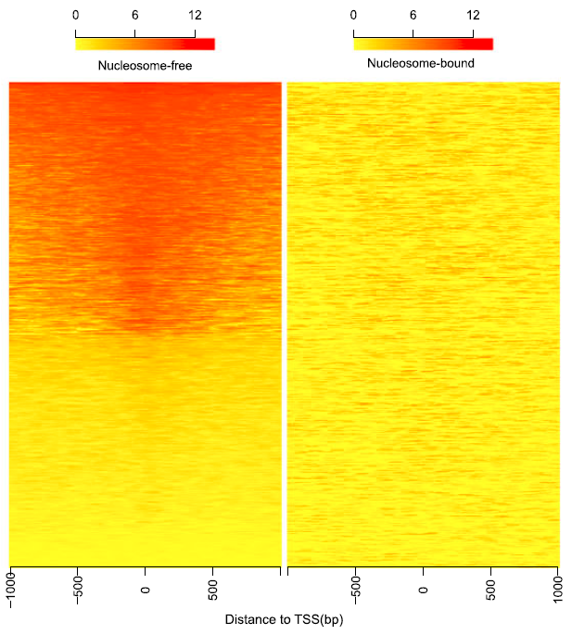
Heatmaps showing distribution of reads from different bins around TSSs
A (High quality)
B (Poor quality)
(Ou et al. 2018)

Slide 22
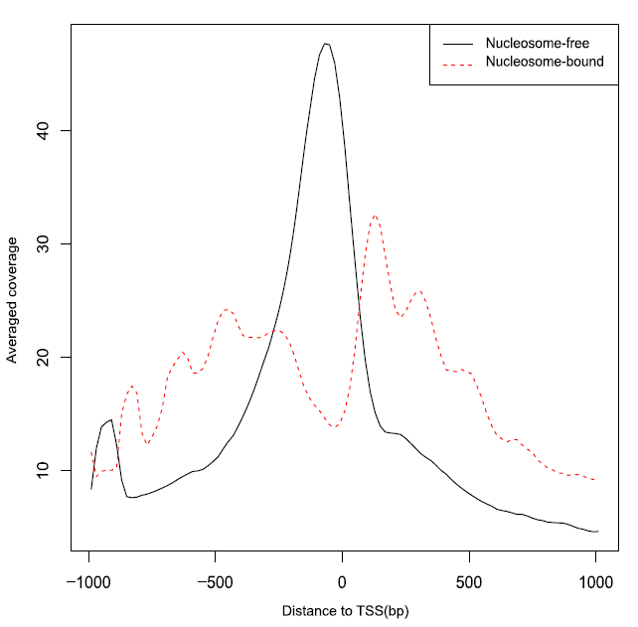
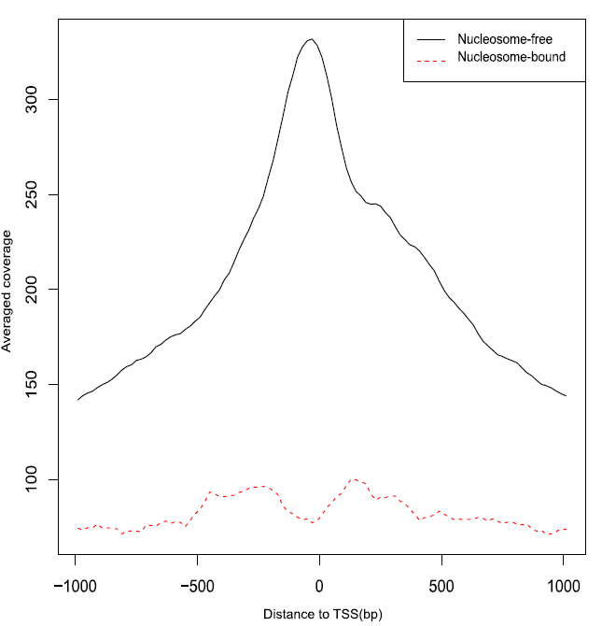
Density plots showing distribution of reads from different bins around TSSs
A (High quality)
B (Poor quality)
(Ou et al. 2018)

Slide 23
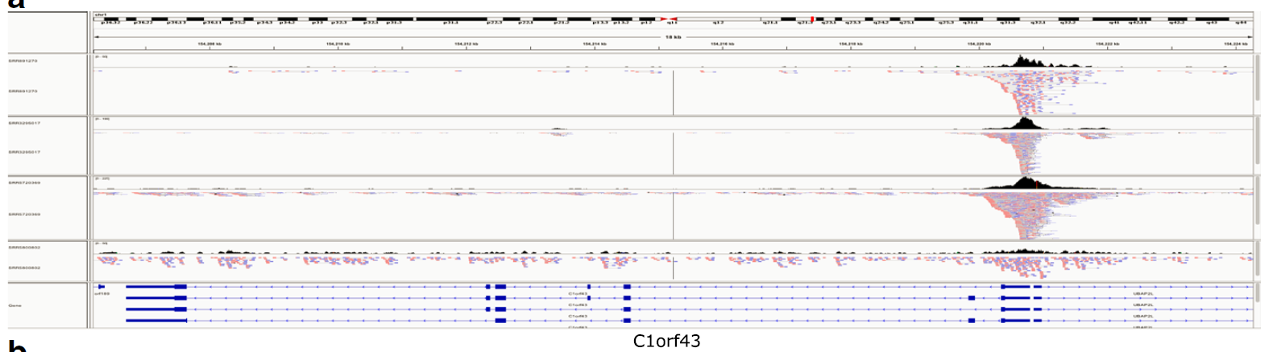
(6) Streamlining IGV snapshots showing reads distribution along HK genes
## access the function IGVSnapshot()
source(system.file("extdata", "IGVSnapshot.R", package = "ATACseqQC"))
## streamline IGV snapshots
IGVSnapshot(maxMem="lm", genomeBuild = "hg19",
bamFileFullPathOrURLs = bamFile,
geneNames = c("C1orf3", "GAPDH"))
(Ou et al. 2018)

Slide 24
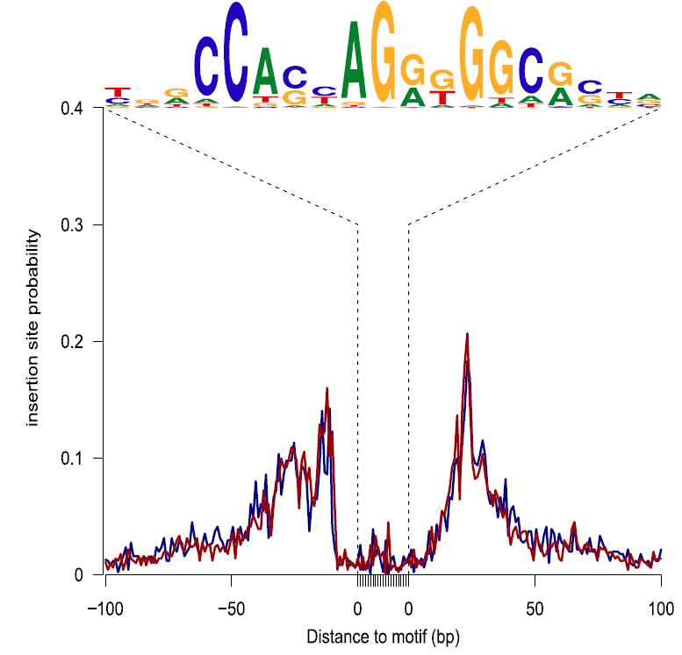
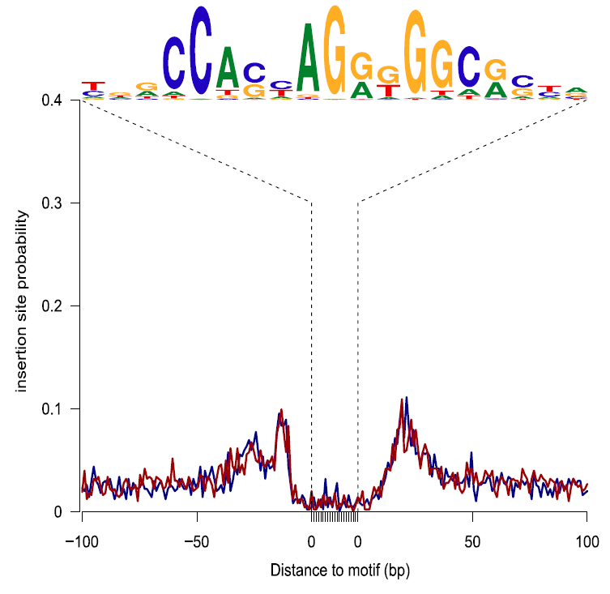
(7) Assessing footprints of DNA-binding factors
## get PWM of TFs
CTCF <- query(MotifDb, c("CTCF"))
CTCF <- as.list(CTCF) print(CTCF[[1]], digits=2)
sigs <- factorFootprints(shiftedBamFile, pfm=CTCF[[1]],
genome=genome, min.score="90%", seqlev=seqlev,
upstream=100, downstream=100)
A (High quality)
B (Poor quality)
(Ou et al. 2018)

Slide 25
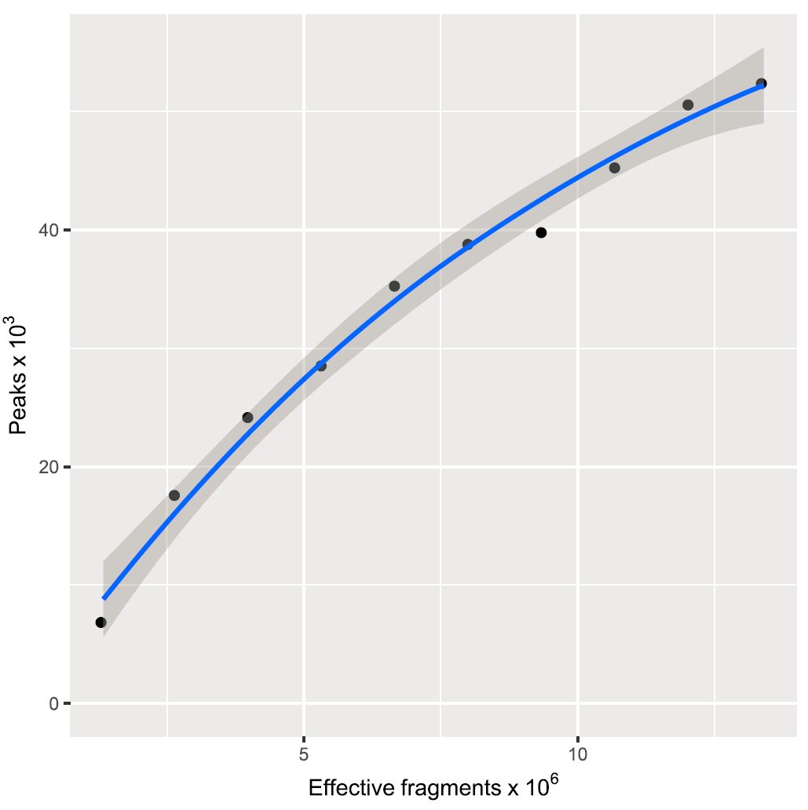
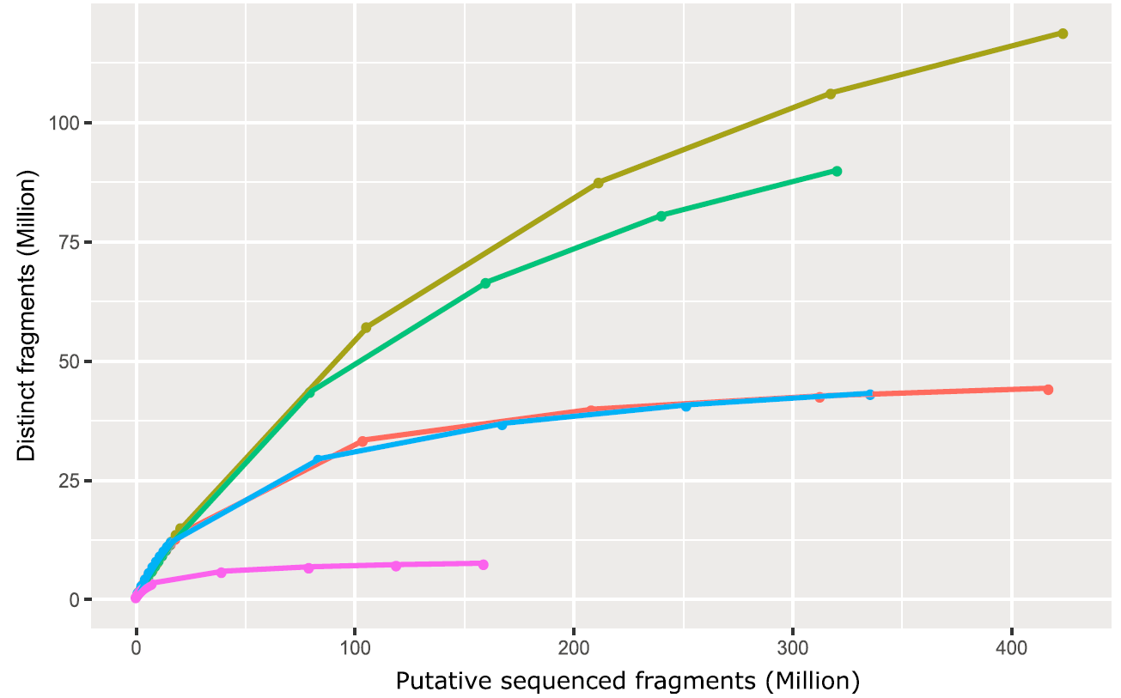
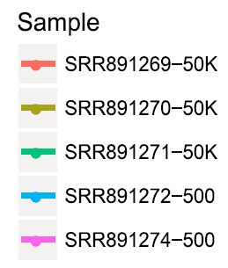
(8) Assessing sequencing depth and library complexity
saturationPlot()
estimateLibComplexity(readsDupFreq(bamFile))
(Ou et al. 2018)

Slide 26
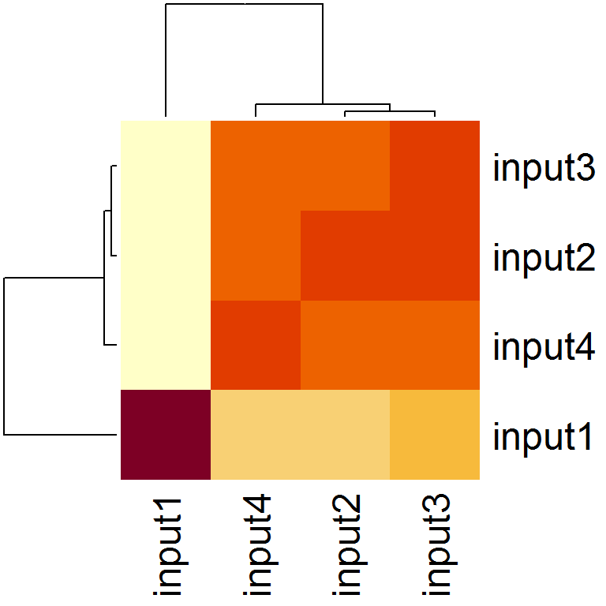
(9) Assessing similarities of replicates
plotCorrelation(GAlignmentsList(gals), txs,
seqlev="chr1")

Slide 27
Outline
Introduction to the ATAC-seq technology
Preprocessing of ATAC-seq data
ATACseqQC workflow
Exercises and live demonstration
Best practices of ATAC-seq assays and ATAC-seq data analyses
Acknowledgement

Slide 28
Exercises and live demonstration
ATAC-seq datasets 1 (Good):
SRR891269 and SRR891270 are ATAC-seq data for two biological replicates of 50K cells from EBV-transformed lymphoblastoid cell line GM12878 (Buenrostro et al. 2013).
ATAC-seq datasets 2 (Bad):
SRR5800801 and SRR5800802 are ATAC-seq data for two replicates of 75k cells from a breast cancer cell line T47 (Valles and Izquierd-Bouldstridge, unpublished).
Raw read quality QC (FASTQC) → Alignment to hg38, excluding alternative sequences (chr_alt_XXX).
The resulting BAM files were further preprocessed as above and are available from the Google Drive.
Two subsets of filtered BAM files from SRR891270, containing alignments on chr20 only, are provided in this workshop package for quick in-class practice.

Slide 29
Exercises and live demonstration
Task 1. Check read alignment statistics using the function bamQC. Using BAM files with marked duplicates.
Task 2. Check library complexity for SRR891270 using the function estimateLibComplexity. CAUTION: duplicated should NOT be removed from the input BAM file.
Task 3. Plot the distribution of library insert size using the function fragSizeDist.
Task 4. Plot global signal enrichment around TSSs using the function enrichedFragments. Please shift, and split the BAM file first. Make sure set seqlev as chr20.
Task 5. Visualize signal distribution along genomic regions of genes “SPTLC3”, “CRLS1”, and “NELFCD”, using the function IGVSnapshotand the 4 subsets of filtered BAM files.

Slide 30
Outline
Introduction to the ATAC-seq technology
Preprocessing of ATAC-seq data
ATACseqQC workflow
Exercises and live demonstration
Best practices of ATAC-seq assays and ATAC-seq data analyses
Acknowledgement

Slide 31
Best practices for ATAC-seq assays
Digest away background DNA (medium/dead cells) using DNase
Use fresh/cyropreserved cells/tissues to isolate nuclei
Reduce mitochondrial/chloroplast DNA contamination as much as possible: bamQC()
Optimize the ratio of the amount of Tn5 enzyme to the number of nuclei: fragSizeDist()
Optimize the number of PCR cycles: bamQC()
Perform paired-end (PE) sequencing, e.g., 2 x 50bp
Sequence > 50M PE reads (~200 M for footprint discovery): saturationPlot(), estimateLibComplexity()

Slide 32
Best practices for ATAC-seq data analyses
Perform raw read QC before alignment--FASTQC
Perform post-alignment QC--ATACSeqQC
Perform peak calling using a peak caller, such as MACS2 in non-broadPeak mode or HMMRATAC
Perform post-peak calling QC
Annotate peaks to nearest genes and generate peak distribution among genomic features--ChIPpeakAnno
Obtain functions of genes associated to peaks using the Genomic Regions Enrichment of Annotations Tool (GREAT)

Slide 33

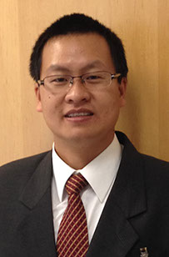

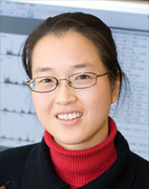


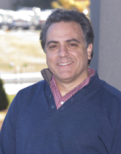



Acknowledgement
Jianhong Ou
Lihua Julie Zhu
Nathan Lawson
Michelle Kelliher
Lucio Castilla
BioC2019 Organization
Committee
Chris Tuggle

